Slide 1
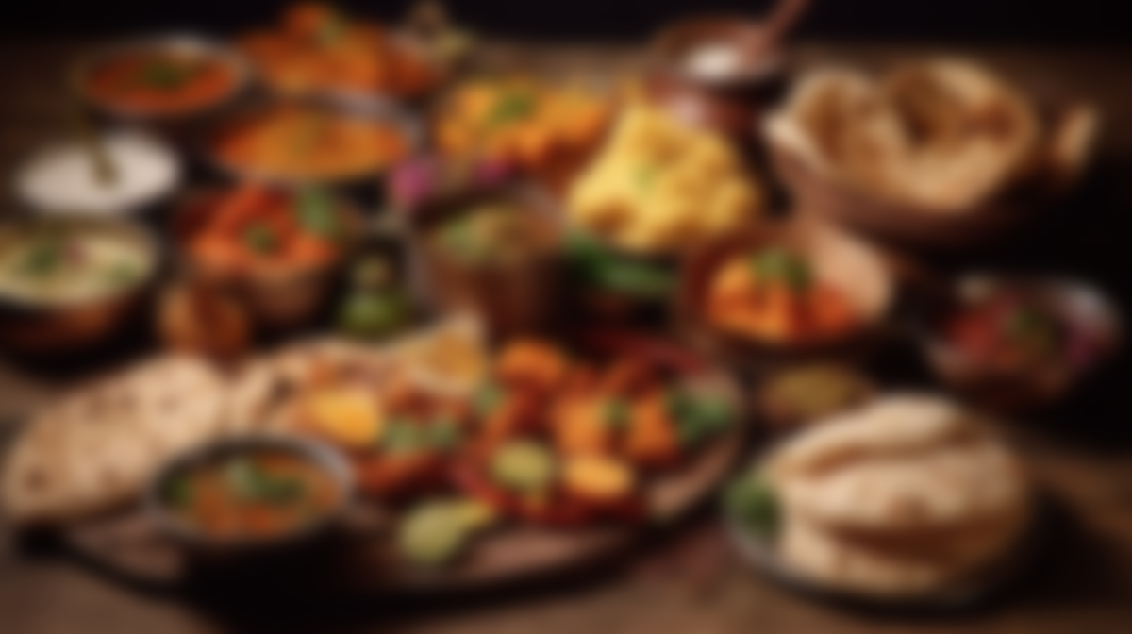

RecipeLens Recipe from image
ASANSOL ENGINEERING COLLEGE
Guided by : Mr. Sudip Kumar De
Presented By
Biplab Gorain (10800221149)
Sheela Bhattacharjee (10800220066)
Bishnu Sharma (10800220065)
Projjol Mitra (10800220059)
Department of Information Technology

Slide 2
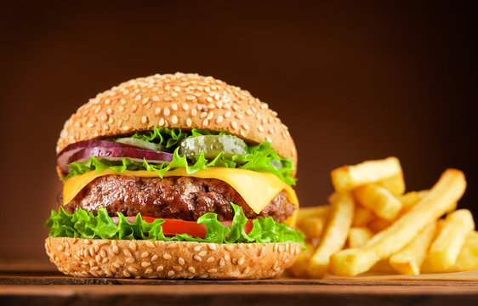
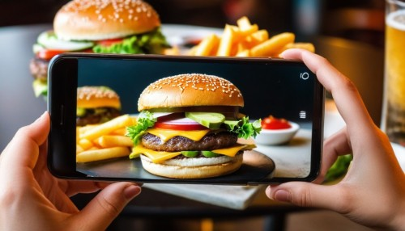
What is RecipeLens?
RecipeLens, from the name itself, we can guess that it’s something related to recipes. But what is the meaning of 'lens' here?
So, RecipeLens is a type of Google Lens. Just as Google Lens helps us find many things from the web by taking images of them, RecipeLens also finds recipes by simply taking images of foods.

Slide 3
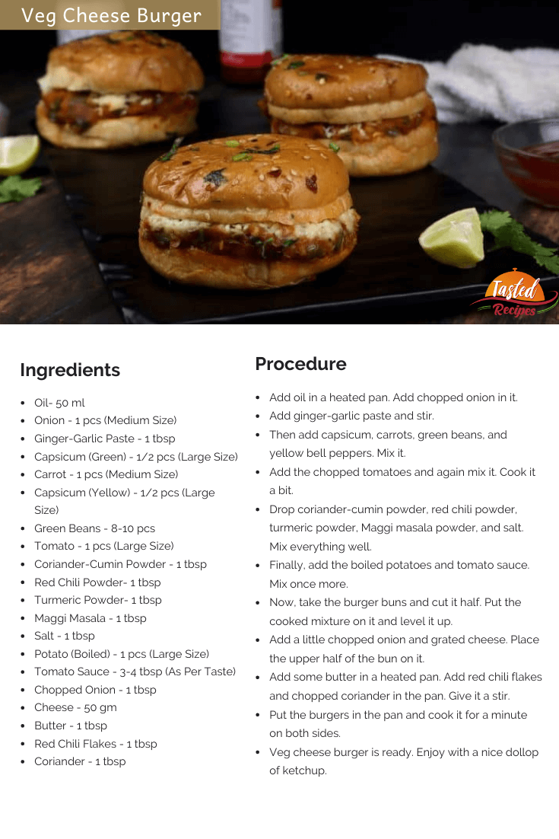
What is RecipeLens?
RecipeLens, from the name itself, we can guess that it’s something related to recipes. But what is the meaning of 'lens' here?
So, RecipeLens is a type of Google Lens. Just as Google Lens helps us find many things from the web by taking images of them, RecipeLens also finds recipes by simply taking images of foods.

Slide 4
What is RecipeLens?
RecipeLens, from the name itself, we can guess that it’s something related to recipes. But what is the meaning of 'lens' here?
So, RecipeLens is a type of Google Lens. Just as Google Lens helps us find many things from the web by taking images of them, RecipeLens also finds recipes by simply taking images of foods.

Slide 5
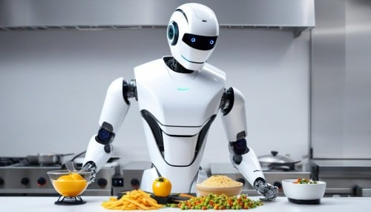
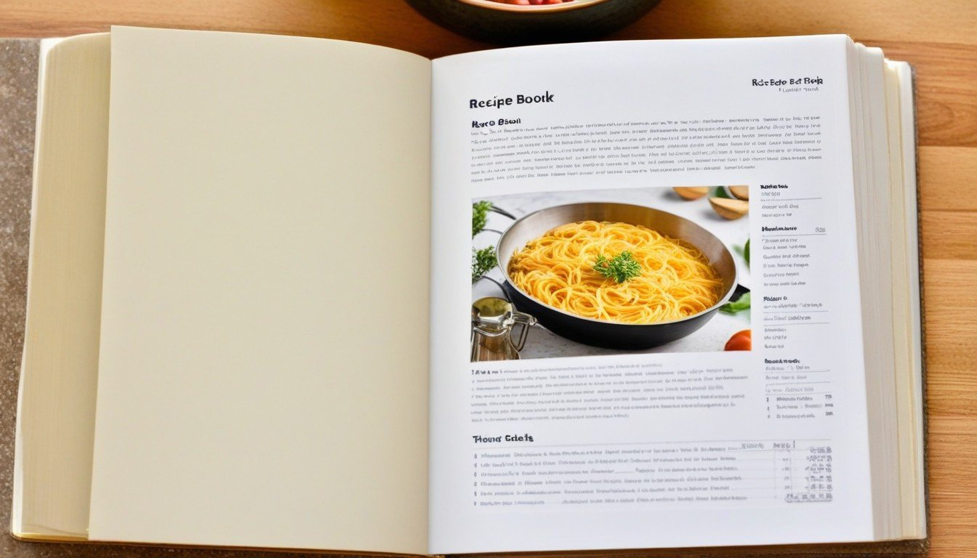
How recipelens work?
The working principal of RecipeLens is given bellow –
Mainly it has two part…
Part 1 –
Classification of food

Slide 6
How recipelens work?
The working principal of RecipeLens is given bellow –
Mainly it has two part…
Part 2 –
Find the recipe of the food
And he finally show the recipe to the user.

Slide 7
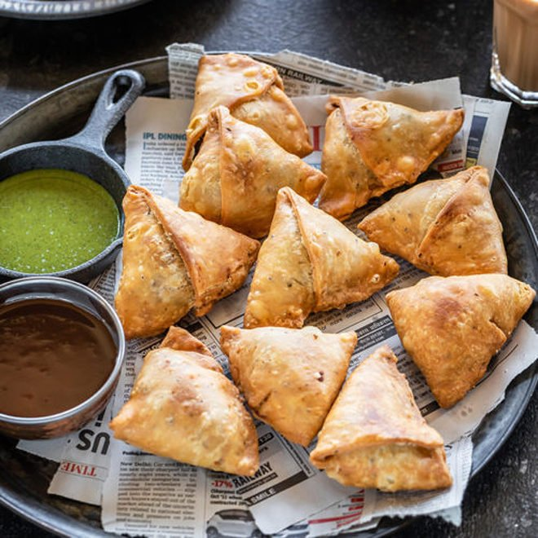
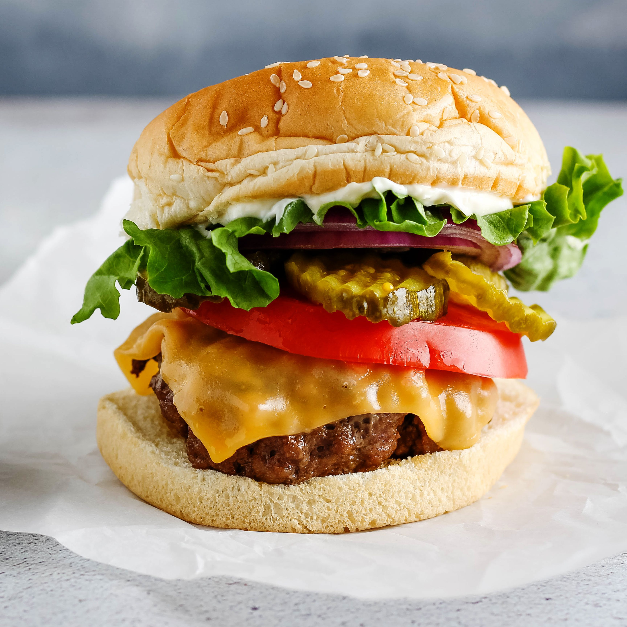
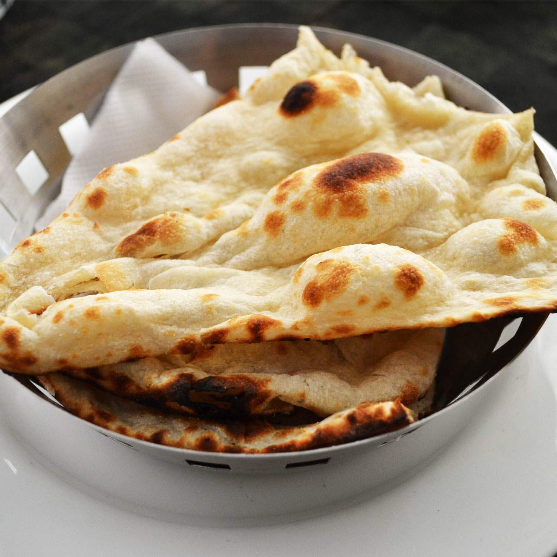
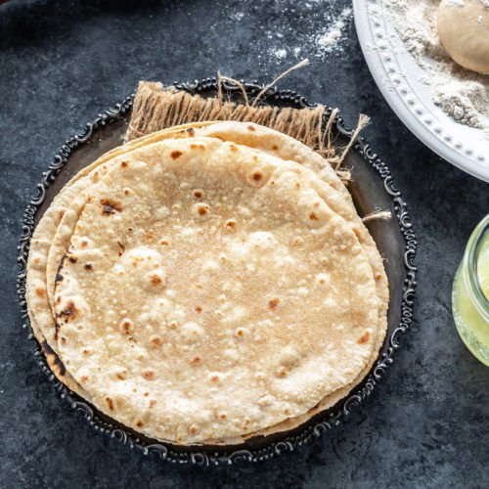
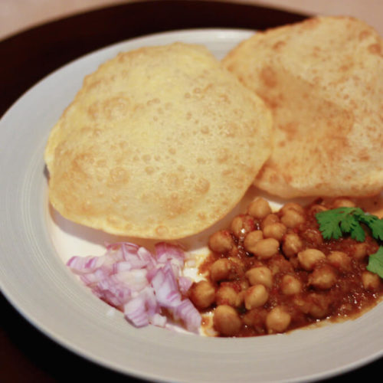
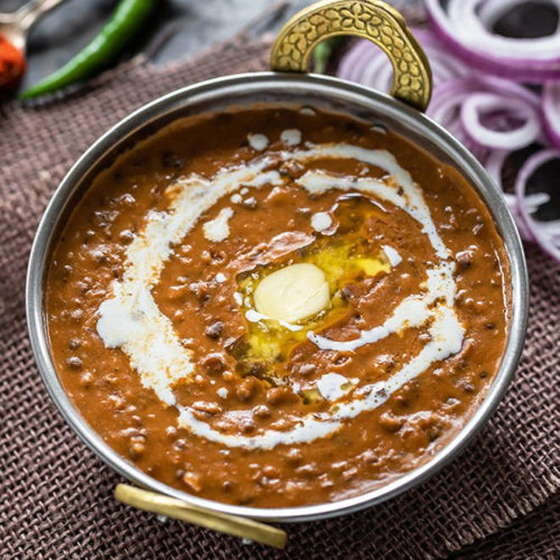
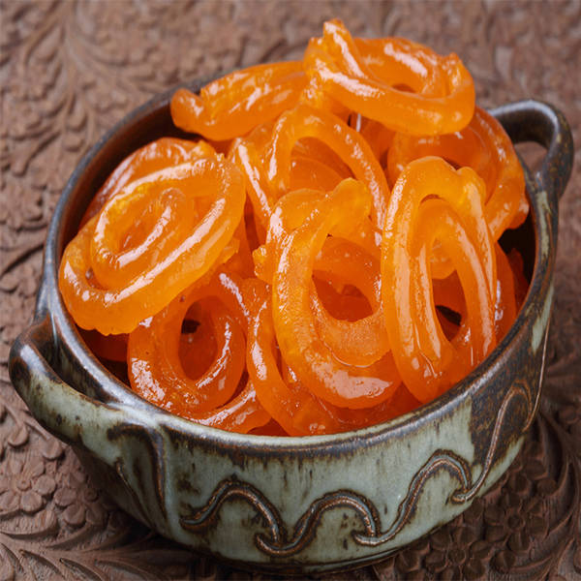
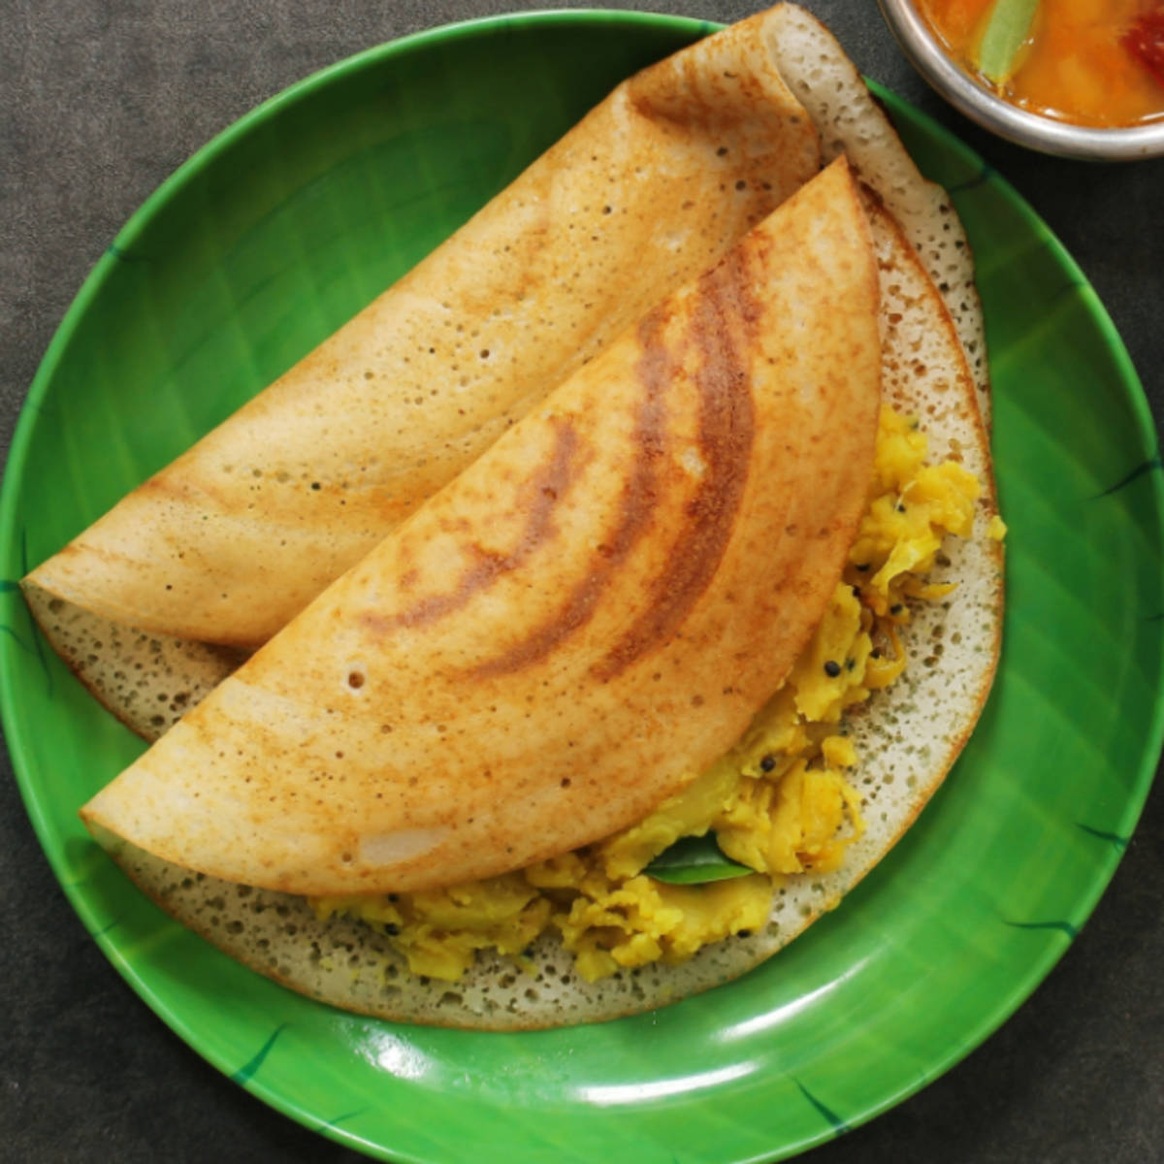
Part 1 : Classification of food
We trained a model that is capable of classifying different foods, such as chapati, kadai paneer, burger, butter naan, chai, momos, etc.
The model is trained using the well-known TensorFlow library.
The accuracy of the model is currently 80%, and improvements are ongoing.
Burger
Burger
Butter naan
Chapati
Chole Bhature
Dal Makhni
Jalebi
Dosa

Slide 8
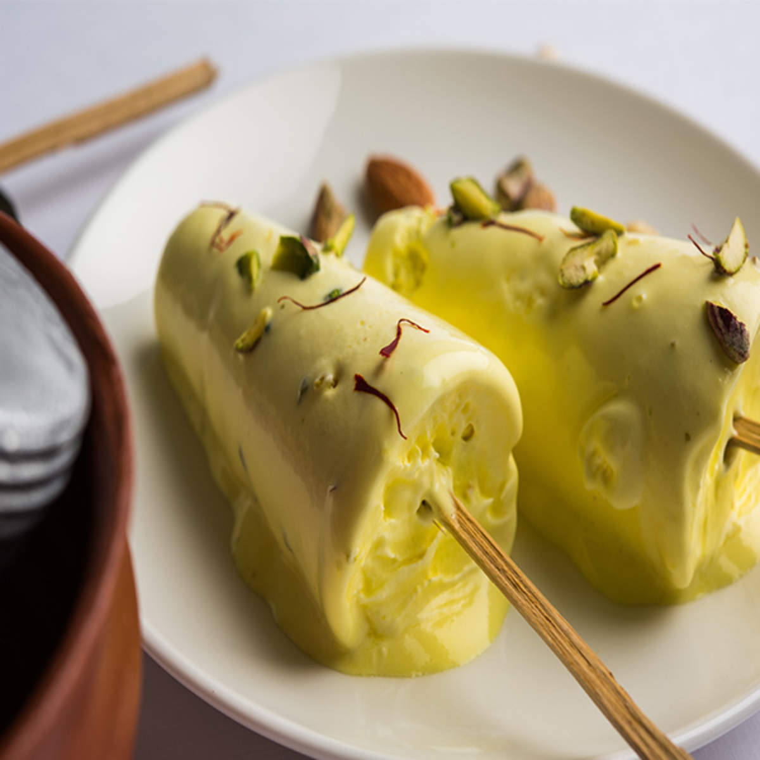
Part 1 : Classification of food
We trained a model that is capable of classifying different foods, such as chapati, kadai paneer, burger, butter naan, chai, momos, etc.
The model is trained using the well-known TensorFlow library.
The accuracy of the model is currently 80%, and improvements are ongoing.
Burger
Burger
Butter naan
Chapati
Chole Bhature
Dal Makhni
Jalebi
Dosa
Kulfi

Slide 9
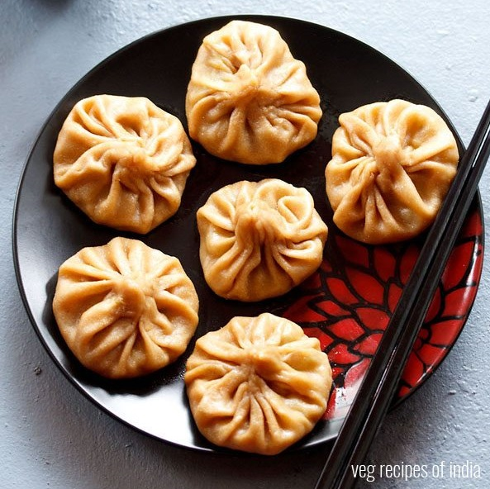
Part 1 : Classification of food
We trained a model that is capable of classifying different foods, such as chapati, kadai paneer, burger, butter naan, chai, momos, etc.
The model is trained using the well-known TensorFlow library.
The accuracy of the model is currently 80%, and improvements are ongoing.
Burger
Butter naan
Chapati
Chole Bhature
Dal Makhni
Jalebi
Dosa
Kulfi
Momos

Slide 10
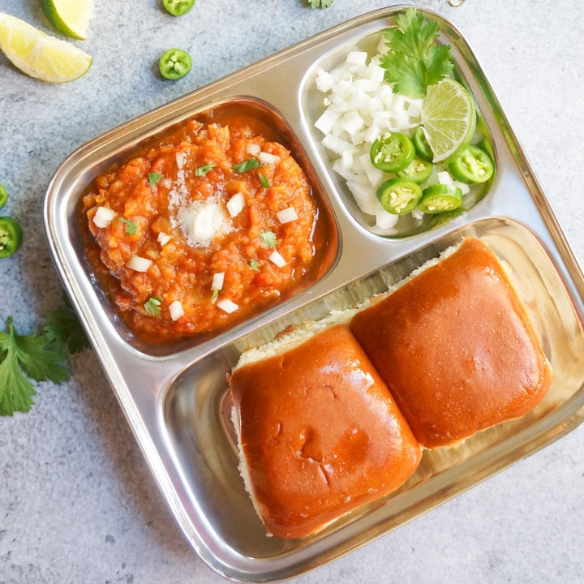
Part 1 : Classification of food
We trained a model that is capable of classifying different foods, such as chapati, kadai paneer, burger, butter naan, chai, momos, etc.
The model is trained using the well-known TensorFlow library.
The accuracy of the model is currently 80%, and improvements are ongoing.
Butter naan
Chapati
Chole Bhature
Dal Makhni
Jalebi
Dosa
Kulfi
Momos
Pav Bhaji

Slide 11
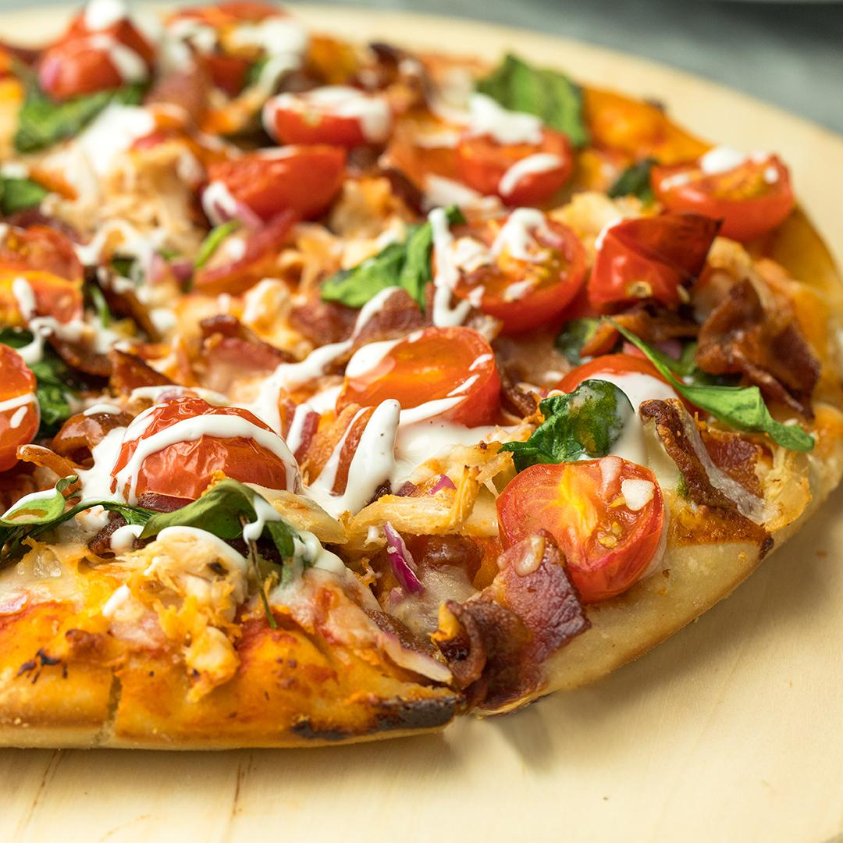
Part 1 : Classification of food
We trained a model that is capable of classifying different foods, such as chapati, kadai paneer, burger, butter naan, chai, momos, etc.
The model is trained using the well-known TensorFlow library.
The accuracy of the model is currently 80%, and improvements are ongoing.
Chapati
Chole Bhature
Dal Makhni
Jalebi
Dosa
Kulfi
Momos
Pav Bhaji
Pizza

Slide 12
Part 1 : Classification of food
We trained a model that is capable of classifying different foods, such as chapati, kadai paneer, burger, butter naan, chai, momos, etc.
The model is trained using the well-known TensorFlow library.
The accuracy of the model is currently 80%, and improvements are ongoing.
Chole Bhature
Dal Makhni
Jalebi
Dosa
Kulfi
Momos
Pav Bhaji
Pizza
Burger

Slide 13
Part 1 : Classification of food
We trained a model that is capable of classifying different foods, such as chapati, kadai paneer, burger, butter naan, chai, momos, etc.
The model is trained using the well-known TensorFlow library.
The accuracy of the model is currently 80%, and improvements are ongoing.
Dal Makhni
Jalebi
Dosa
Kulfi
Momos
Pav Bhaji
Pizza
Burger

Slide 14
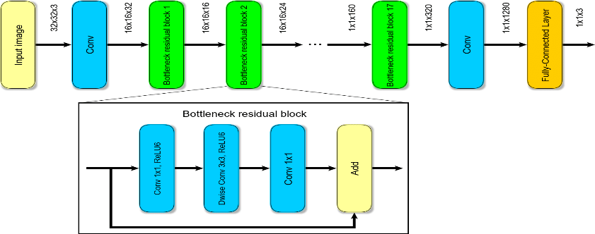
Model
Here the MobileNetV2 architecture of keras TensorFlow, which is a pre-trained convolutional neural network (CNN) for image classification is used.
How MobileNetV2 Works?
MobileNetV2 is trained on large-scale datasets like ImageNet, making it capable of generalizing well to a variety of image recognition tasks. Its efficiency and accuracy make it particularly useful for applications on mobile devices, where computational resources may be limited.

Slide 15
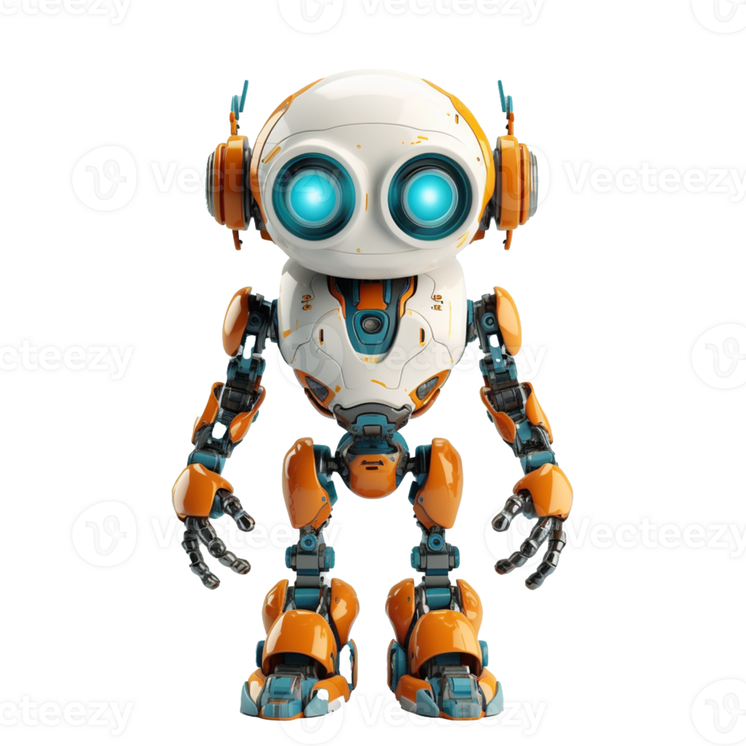
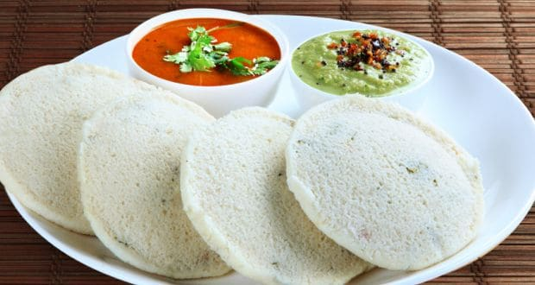
Model
Here the MobileNetV2 architecture of keras TensorFlow, which is a pre-trained convolutional neural network (CNN) for image classification is used.
How MobileNetV2 Works?
MobileNetV2 is trained on large-scale datasets like ImageNet, making it capable of generalizing well to a variety of image recognition tasks. Its efficiency and accuracy make it particularly useful for applications on mobile devices, where computational resources may be limited.

Slide 16
Model
Here the MobileNetV2 architecture of keras TensorFlow, which is a pre-trained convolutional neural network (CNN) for image classification is used.
How MobileNetV2 Works?
MobileNetV2 is trained on large-scale datasets like ImageNet, making it capable of generalizing well to a variety of image recognition tasks. Its efficiency and accuracy make it particularly useful for applications on mobile devices, where computational resources may be limited.

Slide 17
Model
Here the MobileNetV2 architecture of keras TensorFlow, which is a pre-trained convolutional neural network (CNN) for image classification is used.
How MobileNetV2 Works?
MobileNetV2 is trained on large-scale datasets like ImageNet, making it capable of generalizing well to a variety of image recognition tasks. Its efficiency and accuracy make it particularly useful for applications on mobile devices, where computational resources may be limited.
Idli

Slide 18
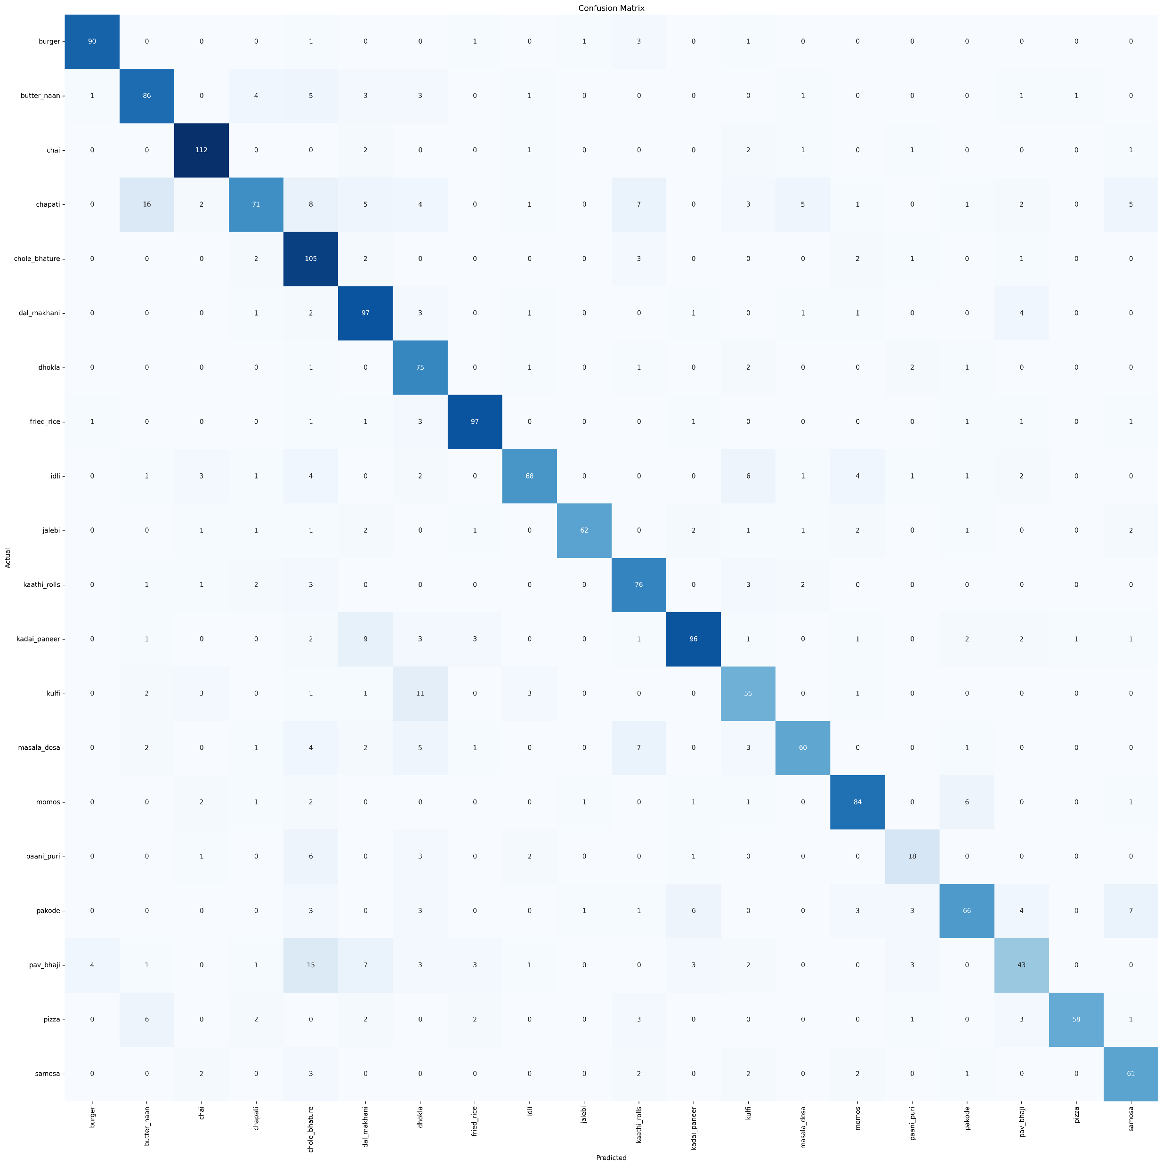
accuracy
The accuracy of the model after trained on the dataset is 80%.
Confusion Matrix –
**The dataset has a total of 20 categories, and the number of images in each category is–
chapati 413, kadai_paneer 412, chole_bhature 411, chai 381, pav_bhaji 353, fried_rice 353, butter_naan 329, dal_makhani 321, momos 319, masala_dosa 311, idli 309, burger 309, jalebi 296, kaathi_rolls 293, dhokla 289, pakode 278, samosa 262, pizza 261, kulfi 236, paani_puri 130

Slide 19
Future works
Fetch the recipe of the image which is classified by the model. (Part 2)
Build a proper user friendly website or app. (Part 2)
Improve the model with more food items.
Recommendation systems based on user preferences, dietary restrictions, and past cooking history

Slide 20
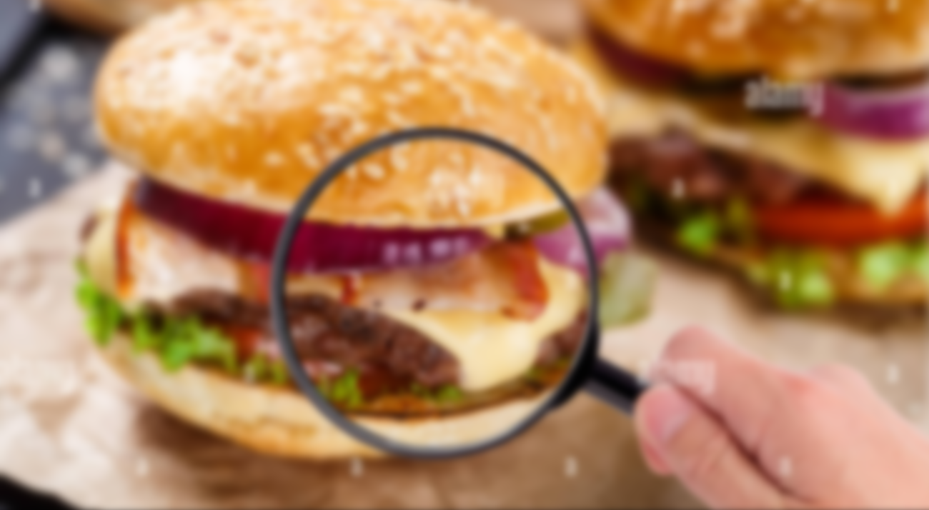
Thank You!

